Slide 1
Uber Data Analysis in R
597 : Data Wrangling
Team : Atharva Adbe
Anchala Krishnan

Slide 2
Goal of the project
To perform Data analysis on Uber data which we collected from Kaggle.
To understand the trends of the customers based on time of day, day of the week and month of the year.
To understand the data and develop an intuition for understanding the customers who avail the trips.

Slide 3
Project Timeline
1
2
3
4
Finding a Credible Data Source
Data Cleaning
Creating Visualizations
Findings and Trends
We found our dataset on Kaggle.com.
We split the dataset into time, hour, date, week, month of the year 2014.
Create charts of customers vs different time units
After looking at the visualizations, we looked at patterns/trends among uber users.

Slide 4
Importing Necessary Libraries
ggplot2 - ggplot2 is the most popular data visualization library that is most widely used for creating aesthetic visualization plots.
lubridate - To use time frames in the dataset.
dplyr - For Data Manipulation.
tidyr - To tidy the data.
DT - For using the Datatables in JS
Scales - With the help of graphical scales, we can automatically map the data to the correct scales with well- placed axes and legends.

Slide 5
Dataset
Source: Kaggle.com
Columns:
Date: date, month, year, time
Latitude
Longitude
Base

Slide 6
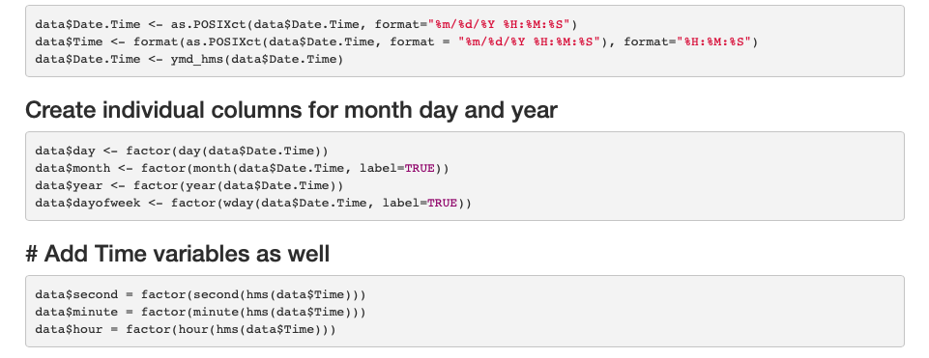
Data Preprocessing
Initial format of the data: m/d/y h/m/s
Final format of the data: new columns of each subpart of the date and time column

Slide 7
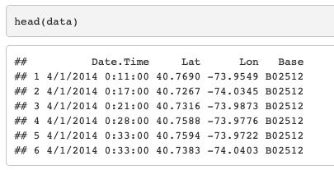
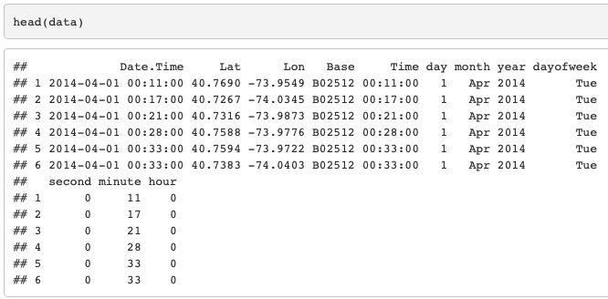
Transformation of Data
Original Data
Final Data

Slide 8
Visualizations

Slide 9
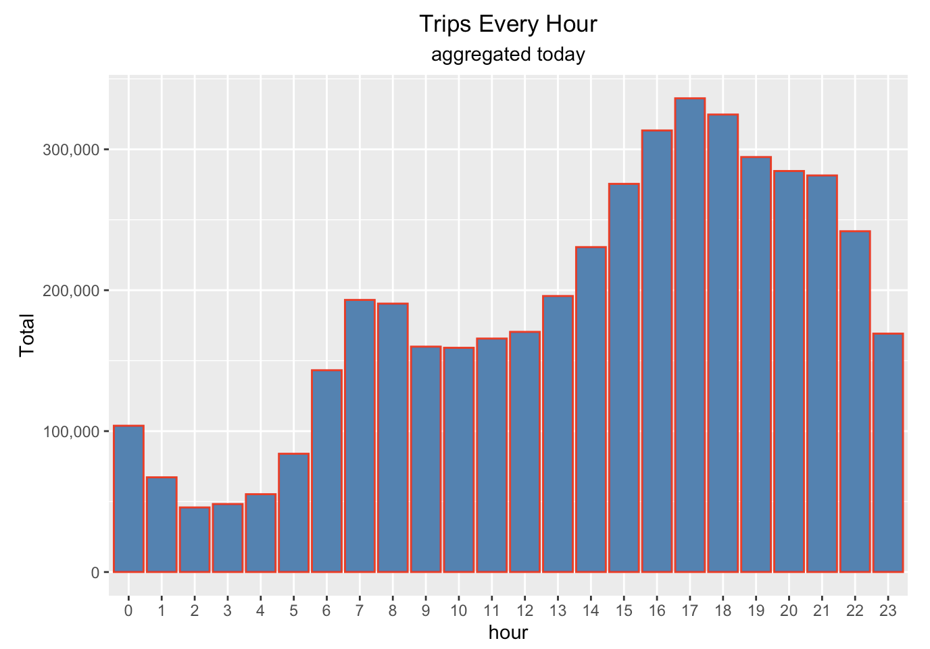
Analysis of Trips by hours in a day

Slide 10
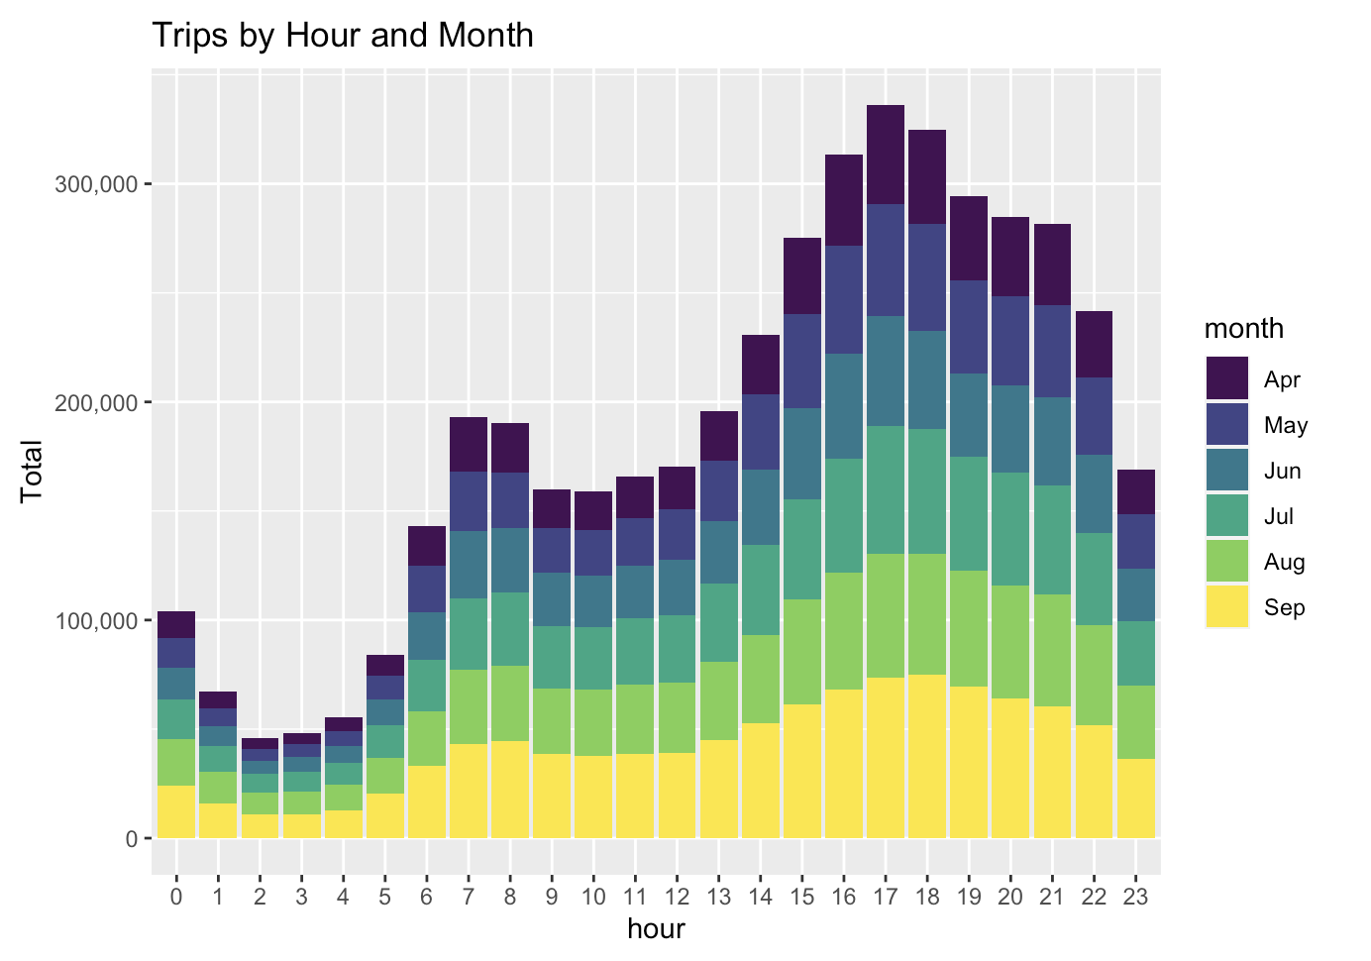
Analysis of trips by hours and month

Slide 11
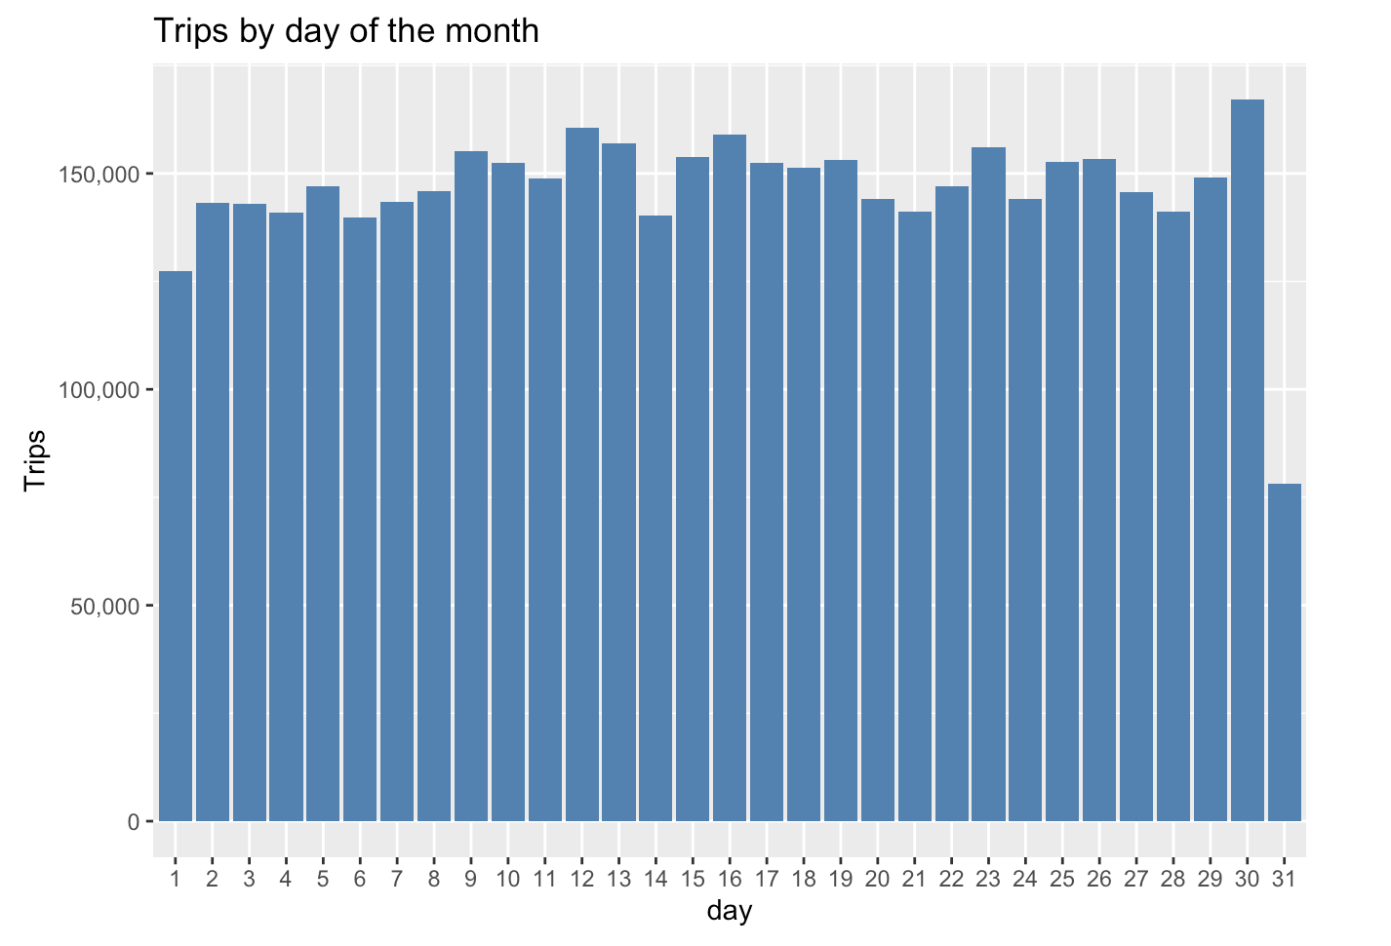
Analysis of Trips by day of the month

Slide 12
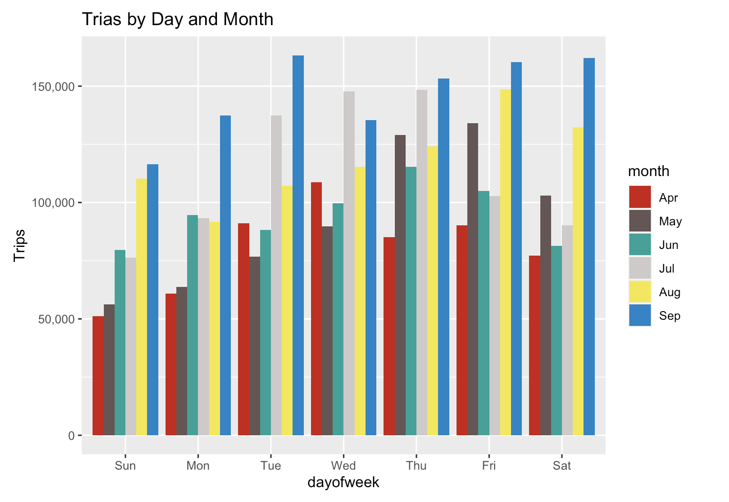
Analysis of Trips by Day of week and Month

Slide 13
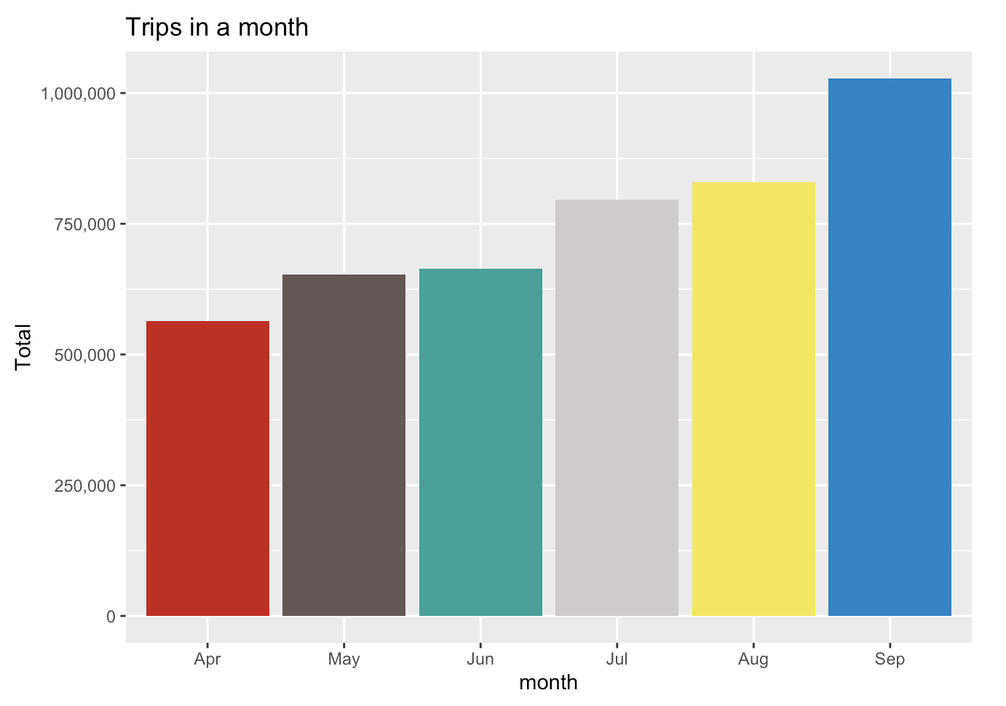
Analysis of Trips By Month

Slide 14
Findings and Trends

Slide 15
Trend analysis
Findings
Busiest month is September while the least busiest is April. Keep in mind that our dataset only includes April-September data
Uber trips in terms of days of the month are relatively the same with first day being a little less popular
In terms of the day of the week, riders prefer mid to later in the week to take uber rides
Evenings are busier for the Uber drivers
Overall, the busiest time is any Tuesday evening of September and the least busiest time is any Monday early mornings of April

Slide 16
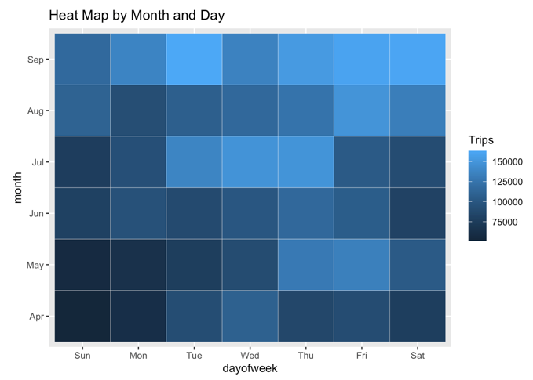
Findings

Slide 17
Thank You

